Slide 1

Bayesian Deep Learning: Normalizing Flows for Implicit Bayesian Neural Networks
Summer Project
Aalto PML
Student: Weijiang Xiong
Supervisor: Dr. Markus Heinonen
24th August 2021
Notes:
Hi everyone, I’m Weijiang Xiong, and I’m very happy to share with you my findings during the summer project
my project is a topic under the broad context of Bayesian deep learning, and I mainly worked on normalizing flows for implicite Bayesian neural networks

Slide 2
Contents
Introduction: Motivation, Challenge and Idea
General Network Structure
Properties and Examples of Normalizing Flow
Loss Formulation
2D Binary Classification Example
Experiment with LeNet and VGG
Discussions
Notes:
In this presentation, I’ll start with the motivation, challenges and idea of my project, followed by the general network structure
Then I’ll briefly introduce normalizing flow, and show the formulation of the loss function
after that I’ll present some experiments and conclude with a few discussions

Slide 3
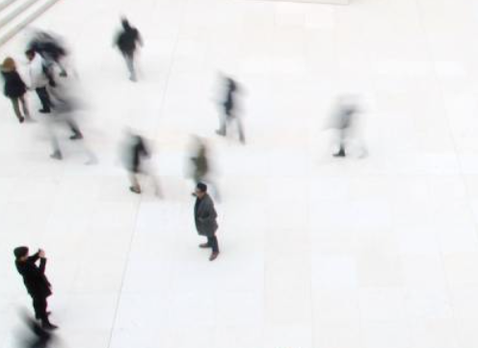
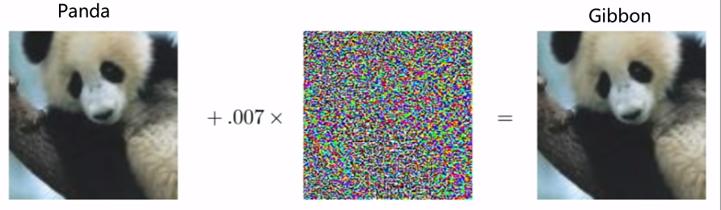
Introduction
Motivation for Bayesian Deep Learning
Classic deep learning only provides a point estimation (deterministic)
Realworld data contains uncertainty (sensor noise), Decision making needs uncertainty
Therefore we want a method to model (input) uncertainty and output probability
Deep neural nets tend to be over confident, even if the results are wrong
Therefore we want our model to be calibrated (confidence matches accuracy)
[1] Left image: https://www.masterclass.com/articles/how-to-capture-motion-blur-in-photography
[2] Right Image: Ian Goodfellow, CS231N Lecture Adversarial Examples and Adversarial Training
Notes:
The motivation of this project comes from two problems in deep neural networks
the first is, they only provide a point estimation, so we call them deterministic networks
but ---
the second problem is, they tend to be over confident. in this adversarial attack example, a neural net classifies this panda as a gibbon with high confidence, which is bad …
reasonably confident,

Slide 4
Introduction
Motivation for Bayesian Deep Learning
Classic deep learning only provides a point estimation (deterministic)
Realworld data contains uncertainty (sensor noise), Decision making needs uncertainty
Therefore we want a method to model (input) uncertainty and output probability
Deep neural nets tend to be over confident, even if the results are wrong
Therefore we want our model to be calibrated (confidence matches accuracy)
Challenges in Bayesian Deep Learning
Neural Nets have too many parameters, difficult to sample a distribution on weights
Difficult to construct expressive but tractable distributions
Project idea
Model the input uncertainty with the Implicit BNN [1]
Build up an expressive distribution with a series of Normalizing Flows
[1] Trung Trinh, Samuel Kaski, Markus Heinonen. Scalable Bayesian neural networks by layer-wise input augmentation https://arxiv.org/abs/2010.13498
Notes:
However, deep neural nets … , and it’s difficult
Besides, it’s also difficult
Therefore my project idea is to … and …
what are they and how are they connected?

Slide 5
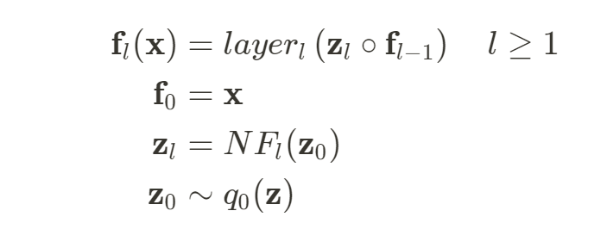
General Network Structure
Stochastic Layer with Normalizing Flow
transformed samples * original input
deterministic
Input
Linear/Conv
Transform with NF
stochastic
transformed
samples
samples
Base Dist.
NF
Sample from a base distribution
Intuitive Understanding
Probabilistic : model the input uncertainty with the flow based distribution
Non-probabilistic: An extension; A learned data augmentation; A more flexible dropout
A network have multiple layers, a layer has a series of flows (network in network)
Notes:
Let’s look at the general structure of the implicit bnn
the IBNN extends a deterministic layer with a stochastic branch
before we put the data/feature into a network layer, we sample … then transform the samples … and I mainly worked on this flow part
finally, we multiply the samples with the original data/feature
This structure has nice intuitive interpretations.
in a probabilistic way, …
in a non-probabilistic way, the stochastic part can be regarded as

Slide 6

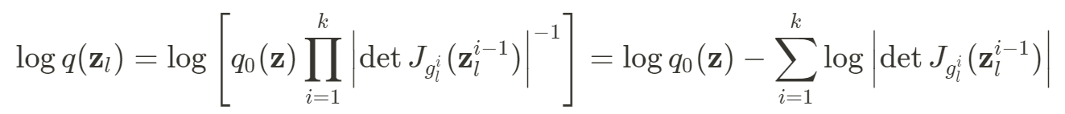
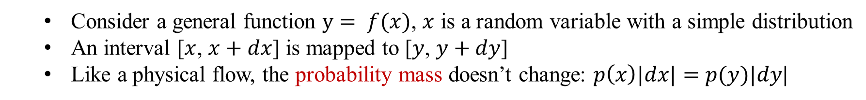


Normalizing Flows: Properties
A transform of random variable
Consider a general function $y= f(x)$, $x$ is a random variable with a simple distribution
An interval [$x$, $x+dx$] is mapped to [$y$, $y+dy$]
Like a physical flow, the probability mass doesn’t change: $p\left(x\right)|dx|=p(y)|dy|$
In log space:
$$\log{p(y)}=\log{p\left(x\right)+\log{|dx/dy|}}$$
The inverse of volume change
$$\log{p(z)}=\log{p\left(y\right)+\log{|dy/dz|}}$$
Add them up and y cancels out
Build complex distribution with a series of transform
scalar => vector
volume change => determinant of Jacobian
Jacobian evaluated at the output of previous flow
Notes:
That’s the general setup, and now let’s look at the flow part
normalizing flow is a transform of random variable, with which we can build complex distributions
consider …
image we push the probability mass through a flow, and the interval [x, x+dx],
like a … that is density * volume
we can write the density of y in log space, and the absolute value of dx/dy means …
when dealing with a series of flows, each flow works independently, and if we connect this flow with another flow, we can easily add up these two equations
y cancels out, and we have the density of z
Therefore we can build ….
if we generalize into vector case, volume change becomes det jacobian
since each flow works independently, we only need the jacobian …
however, it’s usually expensive to calculate the determinant of a matrix, so we need to carefully choose some tractable transform

Slide 7
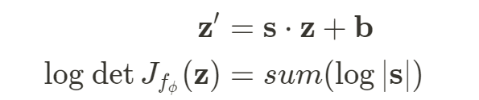
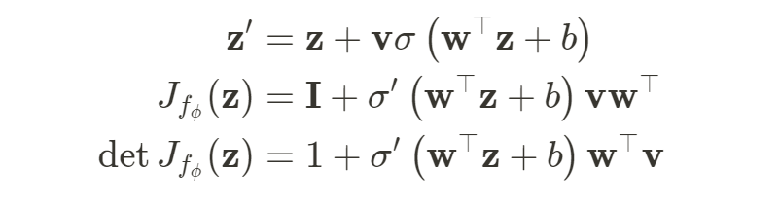


Normalizing Flows: Examples
Affine Transform
Scale and shift the original vector:
log determinant:
Planar Flow
tanh function
Transform:
Jacobian matrix:
determinant:
Invertible 1x1 Convolution (Glow, for images)
2D Convolution:
shared matrix for all (height, width) positions
log determinant:
Notes:
Here are some of them
Affine transform is quite straight forward, and we just scale and shift the input vector
planar flow contains an activation function, and looks a bit more complicated, but its determinant turns out to be quite easy
Another example is the … designed for images
the idea is to multiply all elements xij in an image, with a shared matrix W, and the element-wise log

Slide 8
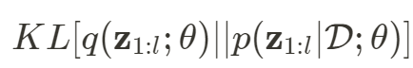
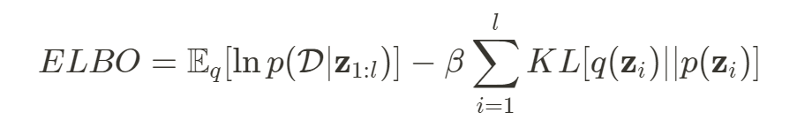
Loss Formulation
Evidence Lower Bound (ELBO)
latent variable in all layers of a neural network
weights of deterministic part (can be copied)
Approximate true distribution with flow:
assume independent layers
Equivalent to maximizing
data likelihood (cross entropy loss)
regularization
Likelihood only needs final prediction, but KL needs more consideration
Notes:
With all the components, let’s move to the loss formulation
In the first place, we want to approximate the true posterior distribution of latent variable p(z|D, theta),
with a flow-based distribution q(z; theta)
here z means .. theta is .. and D is data
That is equivalent to maximizing the ELBO, which contains a data likelihood term and regularization term.
if we assume the latent variables in different layers are independent, we can decompose the full KL into a sum over all layers
while the likelihood …

Slide 9
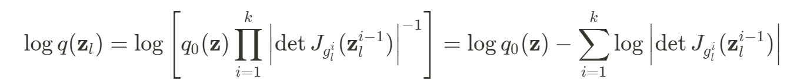
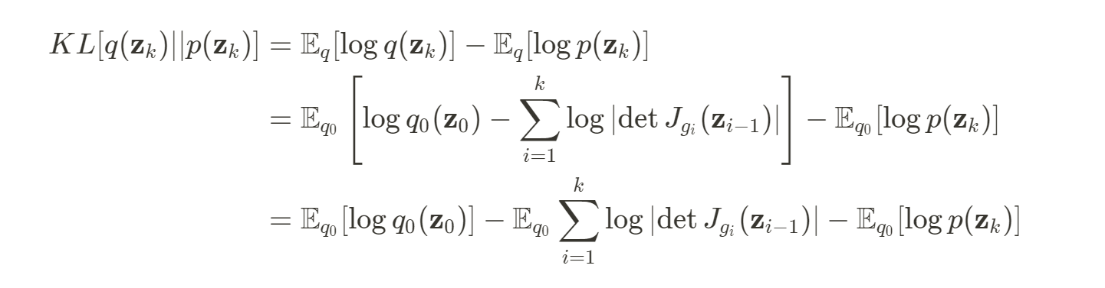
Loss Formulation
Evidence Lower Bound (ELBO)
KL for one layer
the k th flow in this layer
change of variable
log probability of initial samples in base distribution
log probability of transformed samples in prior distribution
sum of log det Jacobian from flow
Notes:
For simplicity we just take one layer,
the notation is actually a bit tricky here, the subscript means the kth flow in a layer
we first plug in the density of transformed samples, then with the change of variable technique,
we can take the expectation over the simple base distribution, instead of the complicated flow posterior
finally the kl decomposes into three terms …

Slide 10
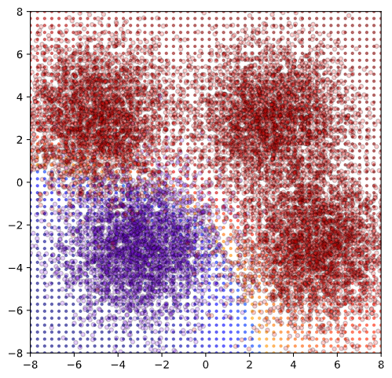
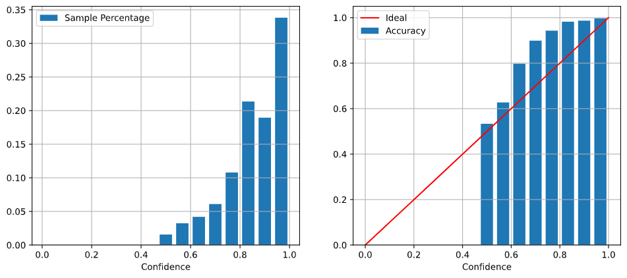
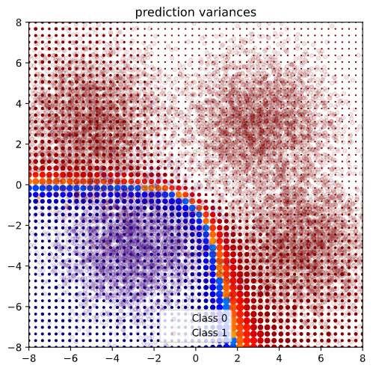
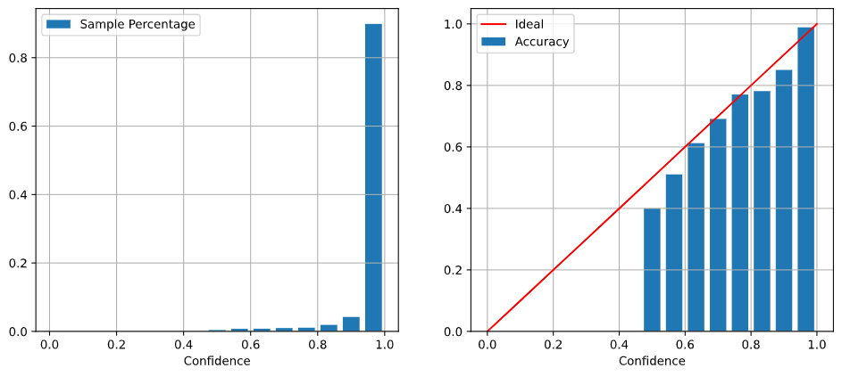
2D Binary Classification
ECE = sum(abs(ACC-Conf)*sample_percentage)
MLP Model
2 Linear Layers
ACC 95.3%
ECE 0.0941
MLP (flow)
2 Linear Layers
Each with 6 planar flows
copy weights from base MLP
ACC 96.5%
ECE 0.009
Notes:
That’s all the theory part, now let’s see some experiments
here is a toy classification problem, and we have a deterministic MLP and a flow based MLP
both have 2 layers, and the flow model has 6 planar flows for each layer
in the second plot, the size of the dots indicates the variance, and we can see it’s quite reasonable
the flow based model is actually initialized with the deterministic mlp, so their boundary looks similar
Apart from classification accuracy, we have a measurement called expected calibration error, ECE, which measures the differences between model confidence and actual accuracy, the lower the better
we can see the flow based MLP has higher accuracy and lower ece, which is great

Slide 11
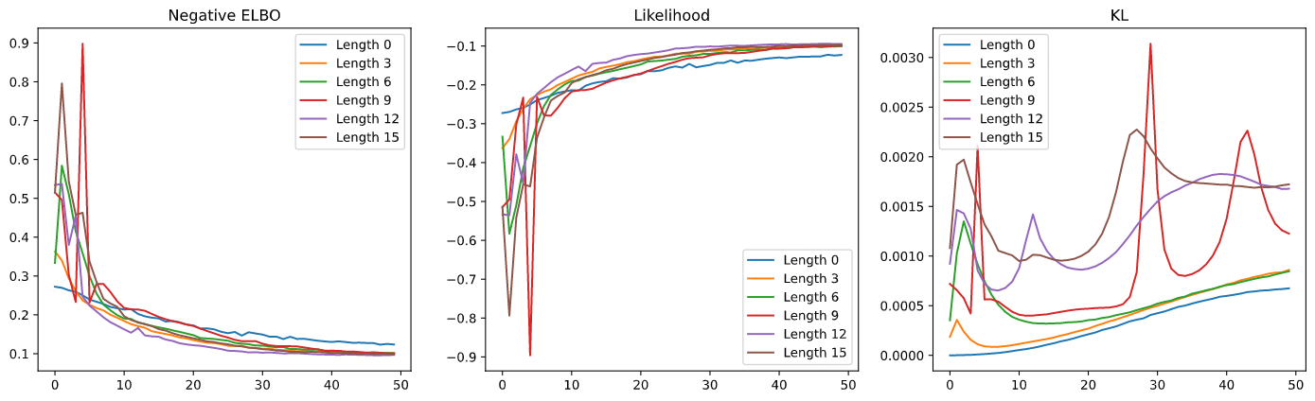
2D Binary Classification
Comparing different flow depth
The model without flow has lowest KL and data likelihood after training
In this case, the flow with length 12 has best ELBO
no flow
Notes:
when I compare the models with different flow depths,
as a result, the model without ….
the likelihood first increases as the flow becomes deeper, and but then decreases a bit
in this case the flow with

Slide 12
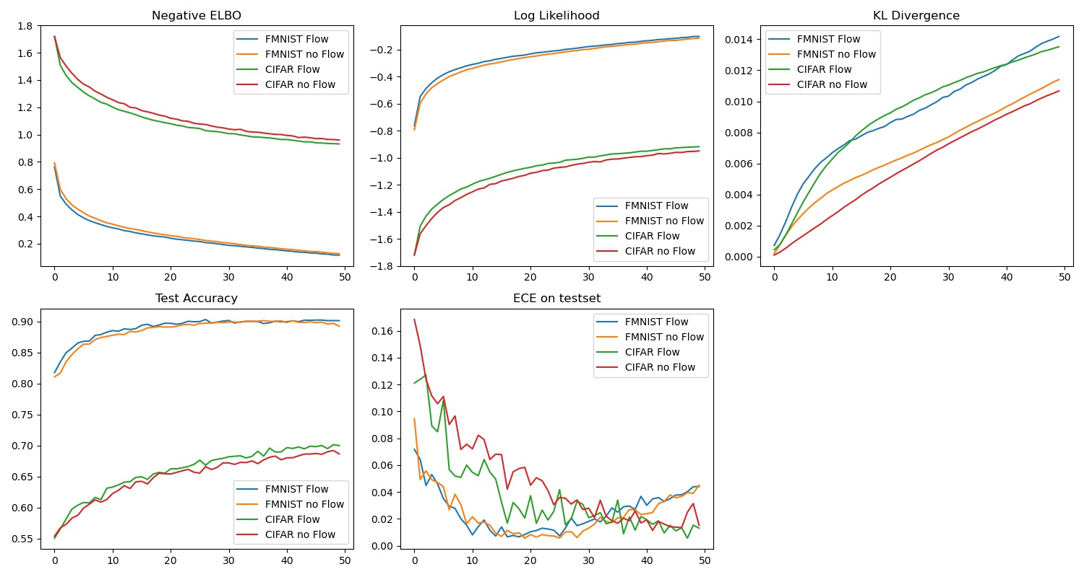
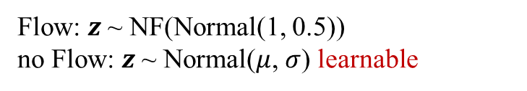
NF on LeNet (5 layers)
Flow config: Normal, InvConv, Normal, Planar, Normal
Flow: $z$ ~ NF(Normal(1, 0.5))
no Flow: $z$ ~ Normal($μ$, $σ$) learnable
FashionMnist Baseline
Deterministic LeNet (best in 50 epochs)
FashionMnist : ~89% ACC, ~1.5% ECE
CIFAR10 Baseline
LeNet Dropout
CIFAR-10: ~65% ACC, ~1.5% ECE
Using Dropout on LeNet:
Same ACC, ECE up to 3~5%
Baseline
Notes:
however, the results become more unpredictable as I moved to bigger models
I experimented the effect of flow on LeNet5, with FashionMNIST and CIFAR10
For the flow part , I used invertible 1x1 convolution for the second convolution layer, and planar flow for the second fully connected layer
For the no flow version, the stochastic part does not have a flow, but only a normal distribution with learnable mean and variance
I trained a deterministic version on the two datasets, and used them as baseline.
I also tried to add dropout to LeNet, but the results doesn’t change much
As a result, both the flow and no flow version outperforms the deterministic baseline, because the test accuracy is higher than baseline
but the flow has little effect on FashionMNIST.
probably it’s because the dataset is simple, and the deterministic model itself is enough to model it
When we look at the test accuracy from cifar, the flow now shows some effect, the test accuracy

Slide 13
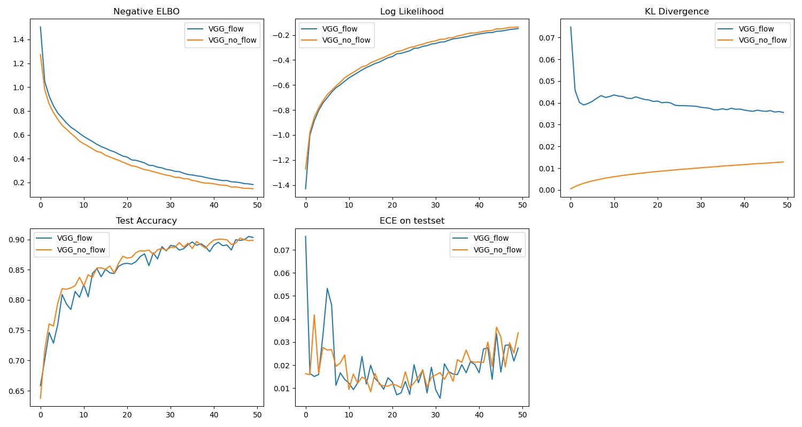

NF on VGG
Flow: $z$ ~ NF(Normal(1, 0.5))
no Flow: $z$ ~ Normal($μ$, $σ$) learnable
Baseline
Baseline
Deterministic VGG (best in 80 epochs)
CIFAR-10: ~87% ACC, ~7% ECE
Notes:
the results with VGG on CIFAR supports that interpretation
both stochastic models outperform the deterministic baseline, but the flow is not helpful here
an evidence is that the KL decreases as training goes on the KL divergence is decreasing, which means the posterior is gradually going back to the prior
so I think VGG 16 has enough capacity for CIFAR 10, and the flow gradually loses its value

Slide 14
Discussions
Key Findings in Project
Normalizing flow is a tractable way to construct/learn flexible distributions
Choosing the structure of flow needs a lot of engineering insight
A flow increases the model’s capacity, and (good case) improve accuracy and calibration
If the model has enough capacity, adding a flow won’t be much helpful
Plans for next days
More experiments to inspect the effect of flow
Document the project and write a summary
Notes:
The project is about to end, and it has been a really nice journey for me
Especially want to thank Markus, Anirudh Trung, because they helped me through the difficulties in my project

Slide 15



Drawings
General Structure
Stochastic Layer
Deterministic
Det. Compo
Input
Det. Compo
Base + NF
Stochastic
transformed
samples
$$⋮$$
samples
Det. Layers
Base Dist.
NF
$$⋮$$
Det. Compo
Flow Layer
Flow Layer
Flow Layer
transformed
samples
samples
$$⋯$$
Base + NF

